Slide 1
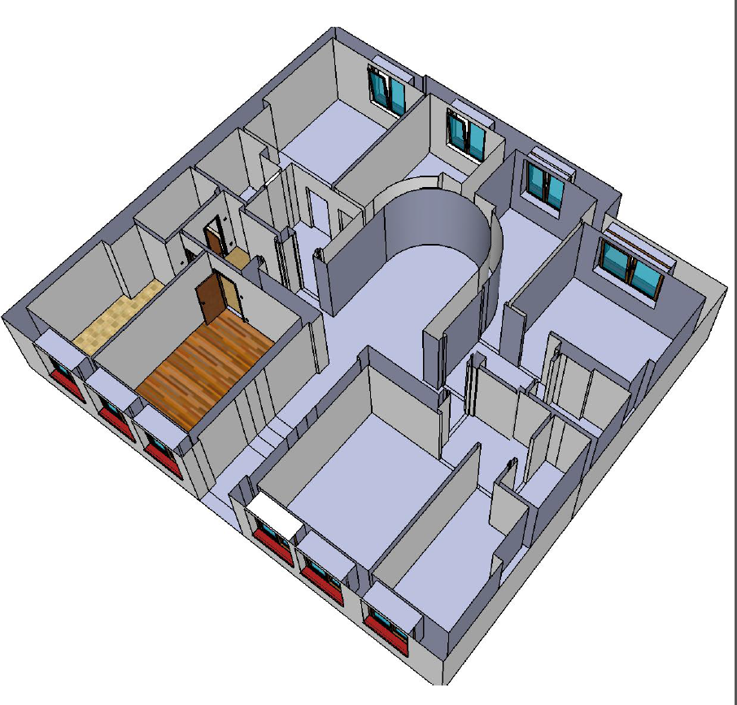
Smartbuilding
Marcin Bajer Kraków, 03.09.2015

Slide 2
Project idea
Project goal is to prepare home automation for medium size rent building/hotel (12 flats).
Off-the-shelf hardware is used (i.e. Arduino/Raspberry Pi/TP-Link TL-WDR4300 routers).
The center of the project is RaspberryPi running the custom prepared web server (node.js based) and some of generic applications (PostgresSQL, Radius server, syslog server, DHCP, DNS…).
In the building there is also a few TP-Link TL-WDR4300 routers (OpenWRT running) which are used not only to provide WiFi, but also as hubs for smart home automation devices.
Virtual USB tunnel is established between TP-Link router and RaspberryPi so USB devices connected to router are seen by the node.js server as if there were directly connected to RaspberryPi.

Slide 3
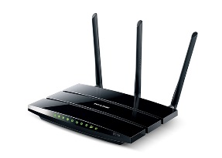

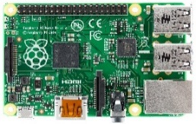





Stage 1 – Network access control and monitoring

Internet
DHCP
DNS
Radius server
Node.js server
Syslog.ng server
OpenVPN
Router
…
…
Access Point
Access Point
Access Point
·
·

…
Guest 1
Administrator
Guest 2
Guest 3
IP camera
Guest network WiFi
(WPA-2 Enterprise)
Admin network WiFi
(WPA-2 PSK)

Slide 4





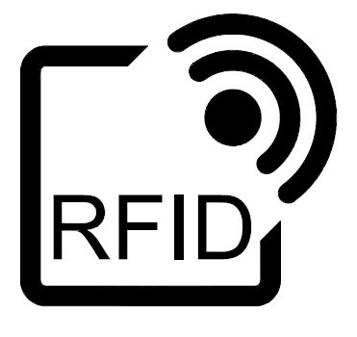

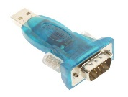
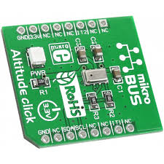
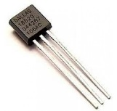
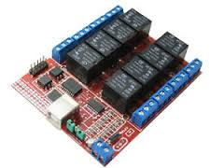


Step 2 – Smart building automation

·
Visualization
(web page)
Internet
OpenVPN
·
Visualization
(external web page)
WiFi
(WPA-2 Enterprise)
Virtual USB
JSON API
…
…
USB
I2C
ONVIF
USB
1wire
Access
control
RS485

Control
board
RS232
IP camera

RS232
(IEC 61107)
Intercom
Light sensor

Electricity
meter
Actuators

Motion
Detectors
Temperature
Sensors

Slide 5
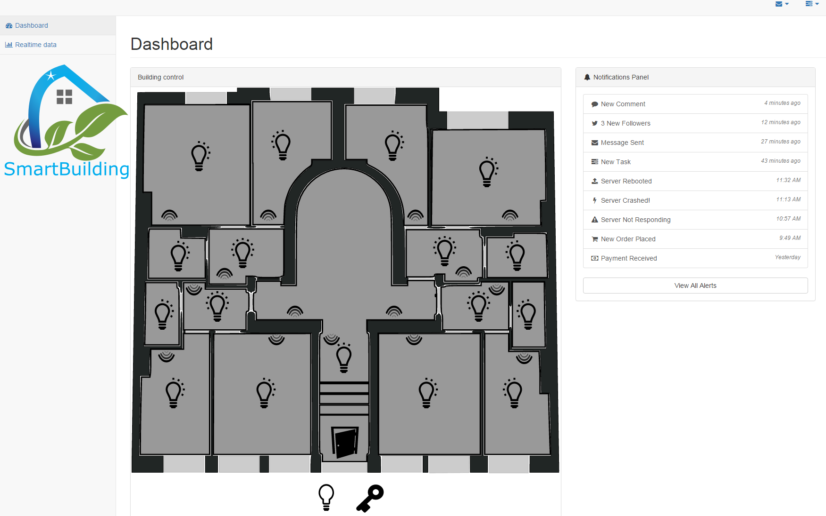

Slide 6
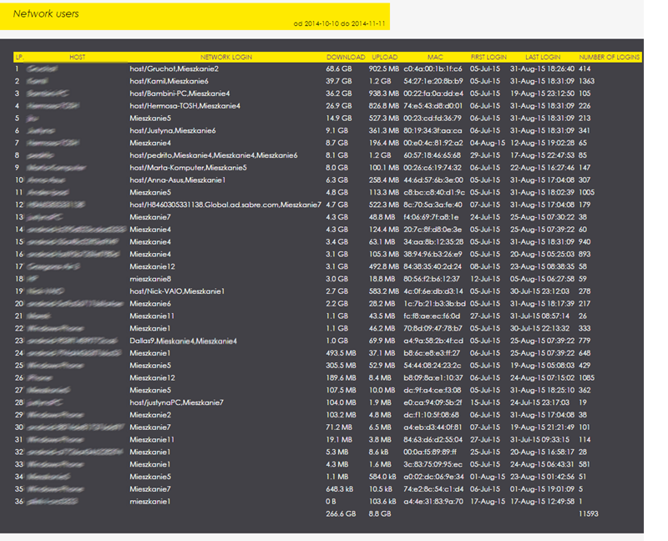

Slide 7
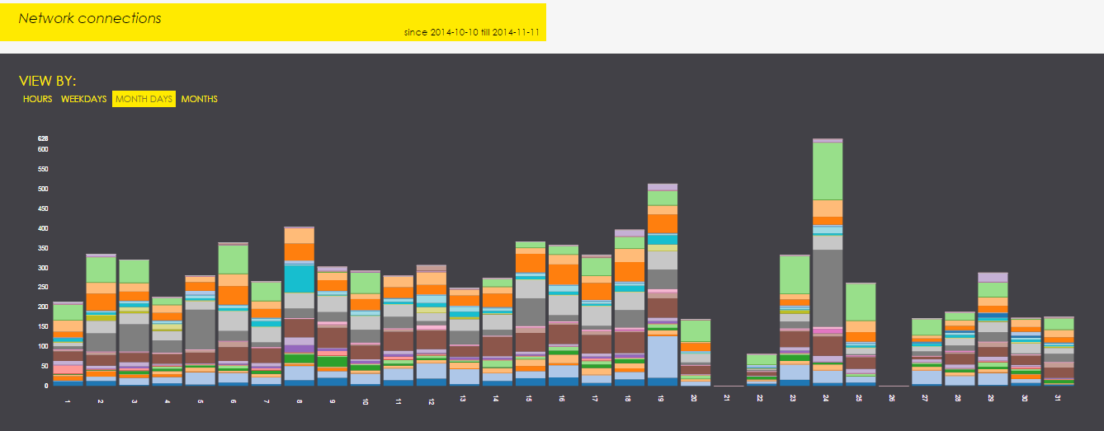
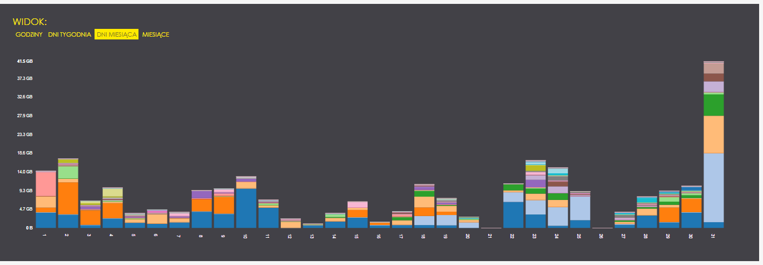

Slide 8
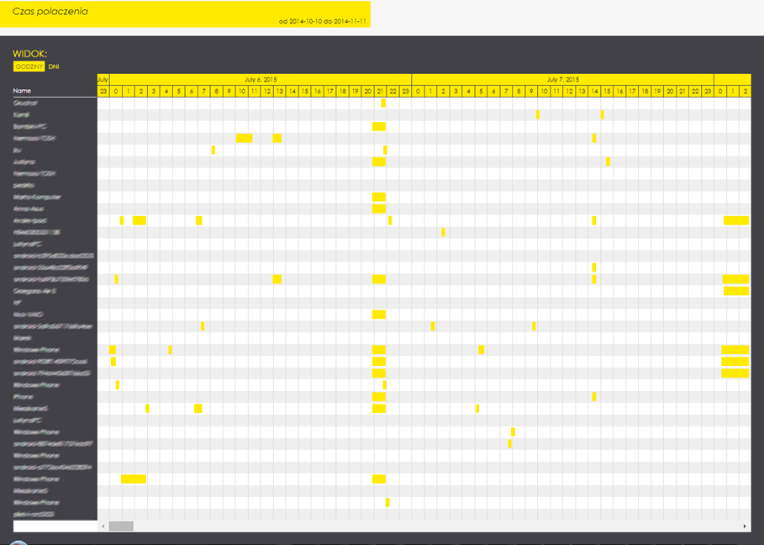

Slide 9
